Slide 1
Project
Programming Books
(Online Book Shopping Site)
Presented by – Samadhan Uttam Babar
Saurabh Subhash Gaikwad
Guide By – Mrs. Joshi B.R

Slide 2
Index
Introduction to System
Project Profile
Scope of System
Need of System
Proposed System

Slide 3
Introduction
The development of a “programming books website” is based on shopping all the BBA (CA) textbooks. Programming books website is chiefly concern purchasing online textbooks, their rates, publishers, deals, generation of various reports.
This Website is designed for shopping books. This website can gives full detailed information which is related to shopping books.
Books details, client details & various blogs, locations and many more details report generation.
It also helps to maintain prices of books done by the reciept of the website. this website has a complete online book purchasing solution that will take care clients.

Slide 4
Scope of System
Programming Books is a complete package for various Coding books.
The basic idea is to provide the fascility to purchase coding books from home.
In these site admin maintains All client information, also maintains client reviews.
Add new deals, offers, and confirm the payment receipt.

Slide 5
Need of System
The current site is not time consuming as the Project manager to write all Project details in MS-Word.
It becomes difficult to keep track of all the Projects.
Management of resources is difficult and allocation of work.
The Project manager finds it difficult as to which teachers have completed their previous task and are free.
Individual or the teams have to report the status. Depending On the Status Project manager has to generate reports.
Status could be generated depending on the task or the date.
Will be helpful in time of emergency.

Slide 6
Proposed System
The main aim is to develop website which takes care of the Student by giving an opportunity to purchase online books instead of offline, using user friendly screens.
It maintains the data and receipt records of the clients related to the purchasing of books
This site is designed so as facilitate the ordering the books of BBA(CA).

Slide 7
System Analysis
Feasibility Study
Operating Environment

Slide 8
Feasibility Study
Similar to all sites while considering proposed site, many aspects and Factors were taken into consideration to which we may call feasibility study.
Following points were considered (question raised) so that the proposed
Site will be easily taken over after completion,
with current setup and will be economical. The result is as follows.

Slide 9
1. Technical Feasibility
It is possible with current technical support and hardware development in the organization to fulfill defined objectives and proposed activities.
HTML, CSS, JAVASCRIPT can be used as Front End to apply better programming skills and to provide better look and feel.
2.Operational Feasibility
The administrator is willing to operate, use and support the proposed
system.

Slide 10
Operating Environment
Software Requirement:-
Operating system: windows 10
Visual Studio, Google Chrome
Hardware Requirement:-
Processor : intel core i3
Ram : 4 GB
Hard Disk Drive: 1GB
CD Rom : 32X Max
Monitor : CRT Monitor

Slide 11
System Design
ER-Diagram
Data Flow Diagram
Class Diagram

Slide 12
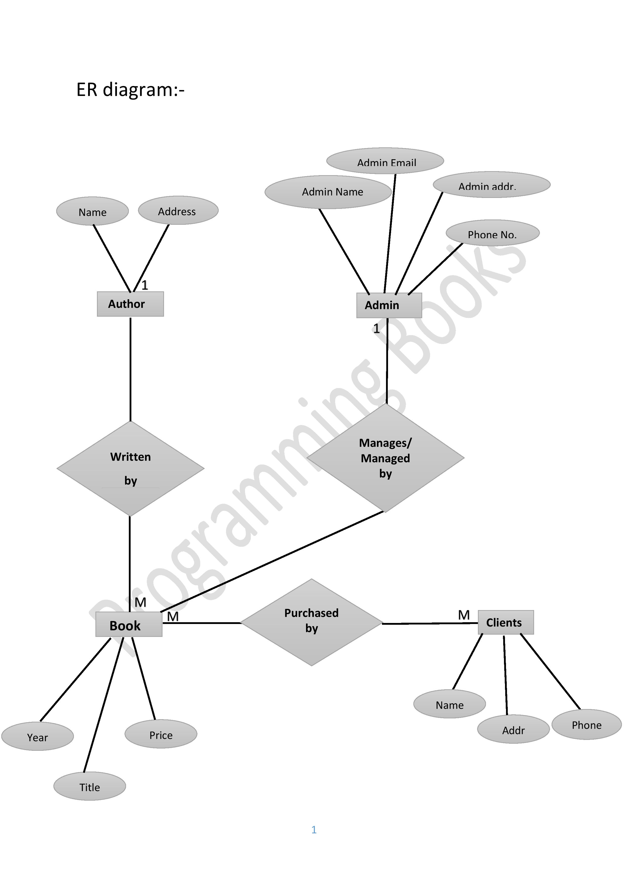

Slide 13
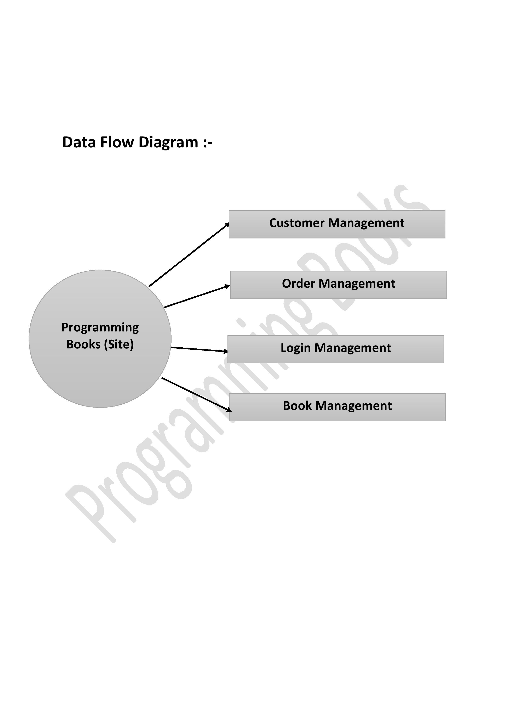

Slide 14
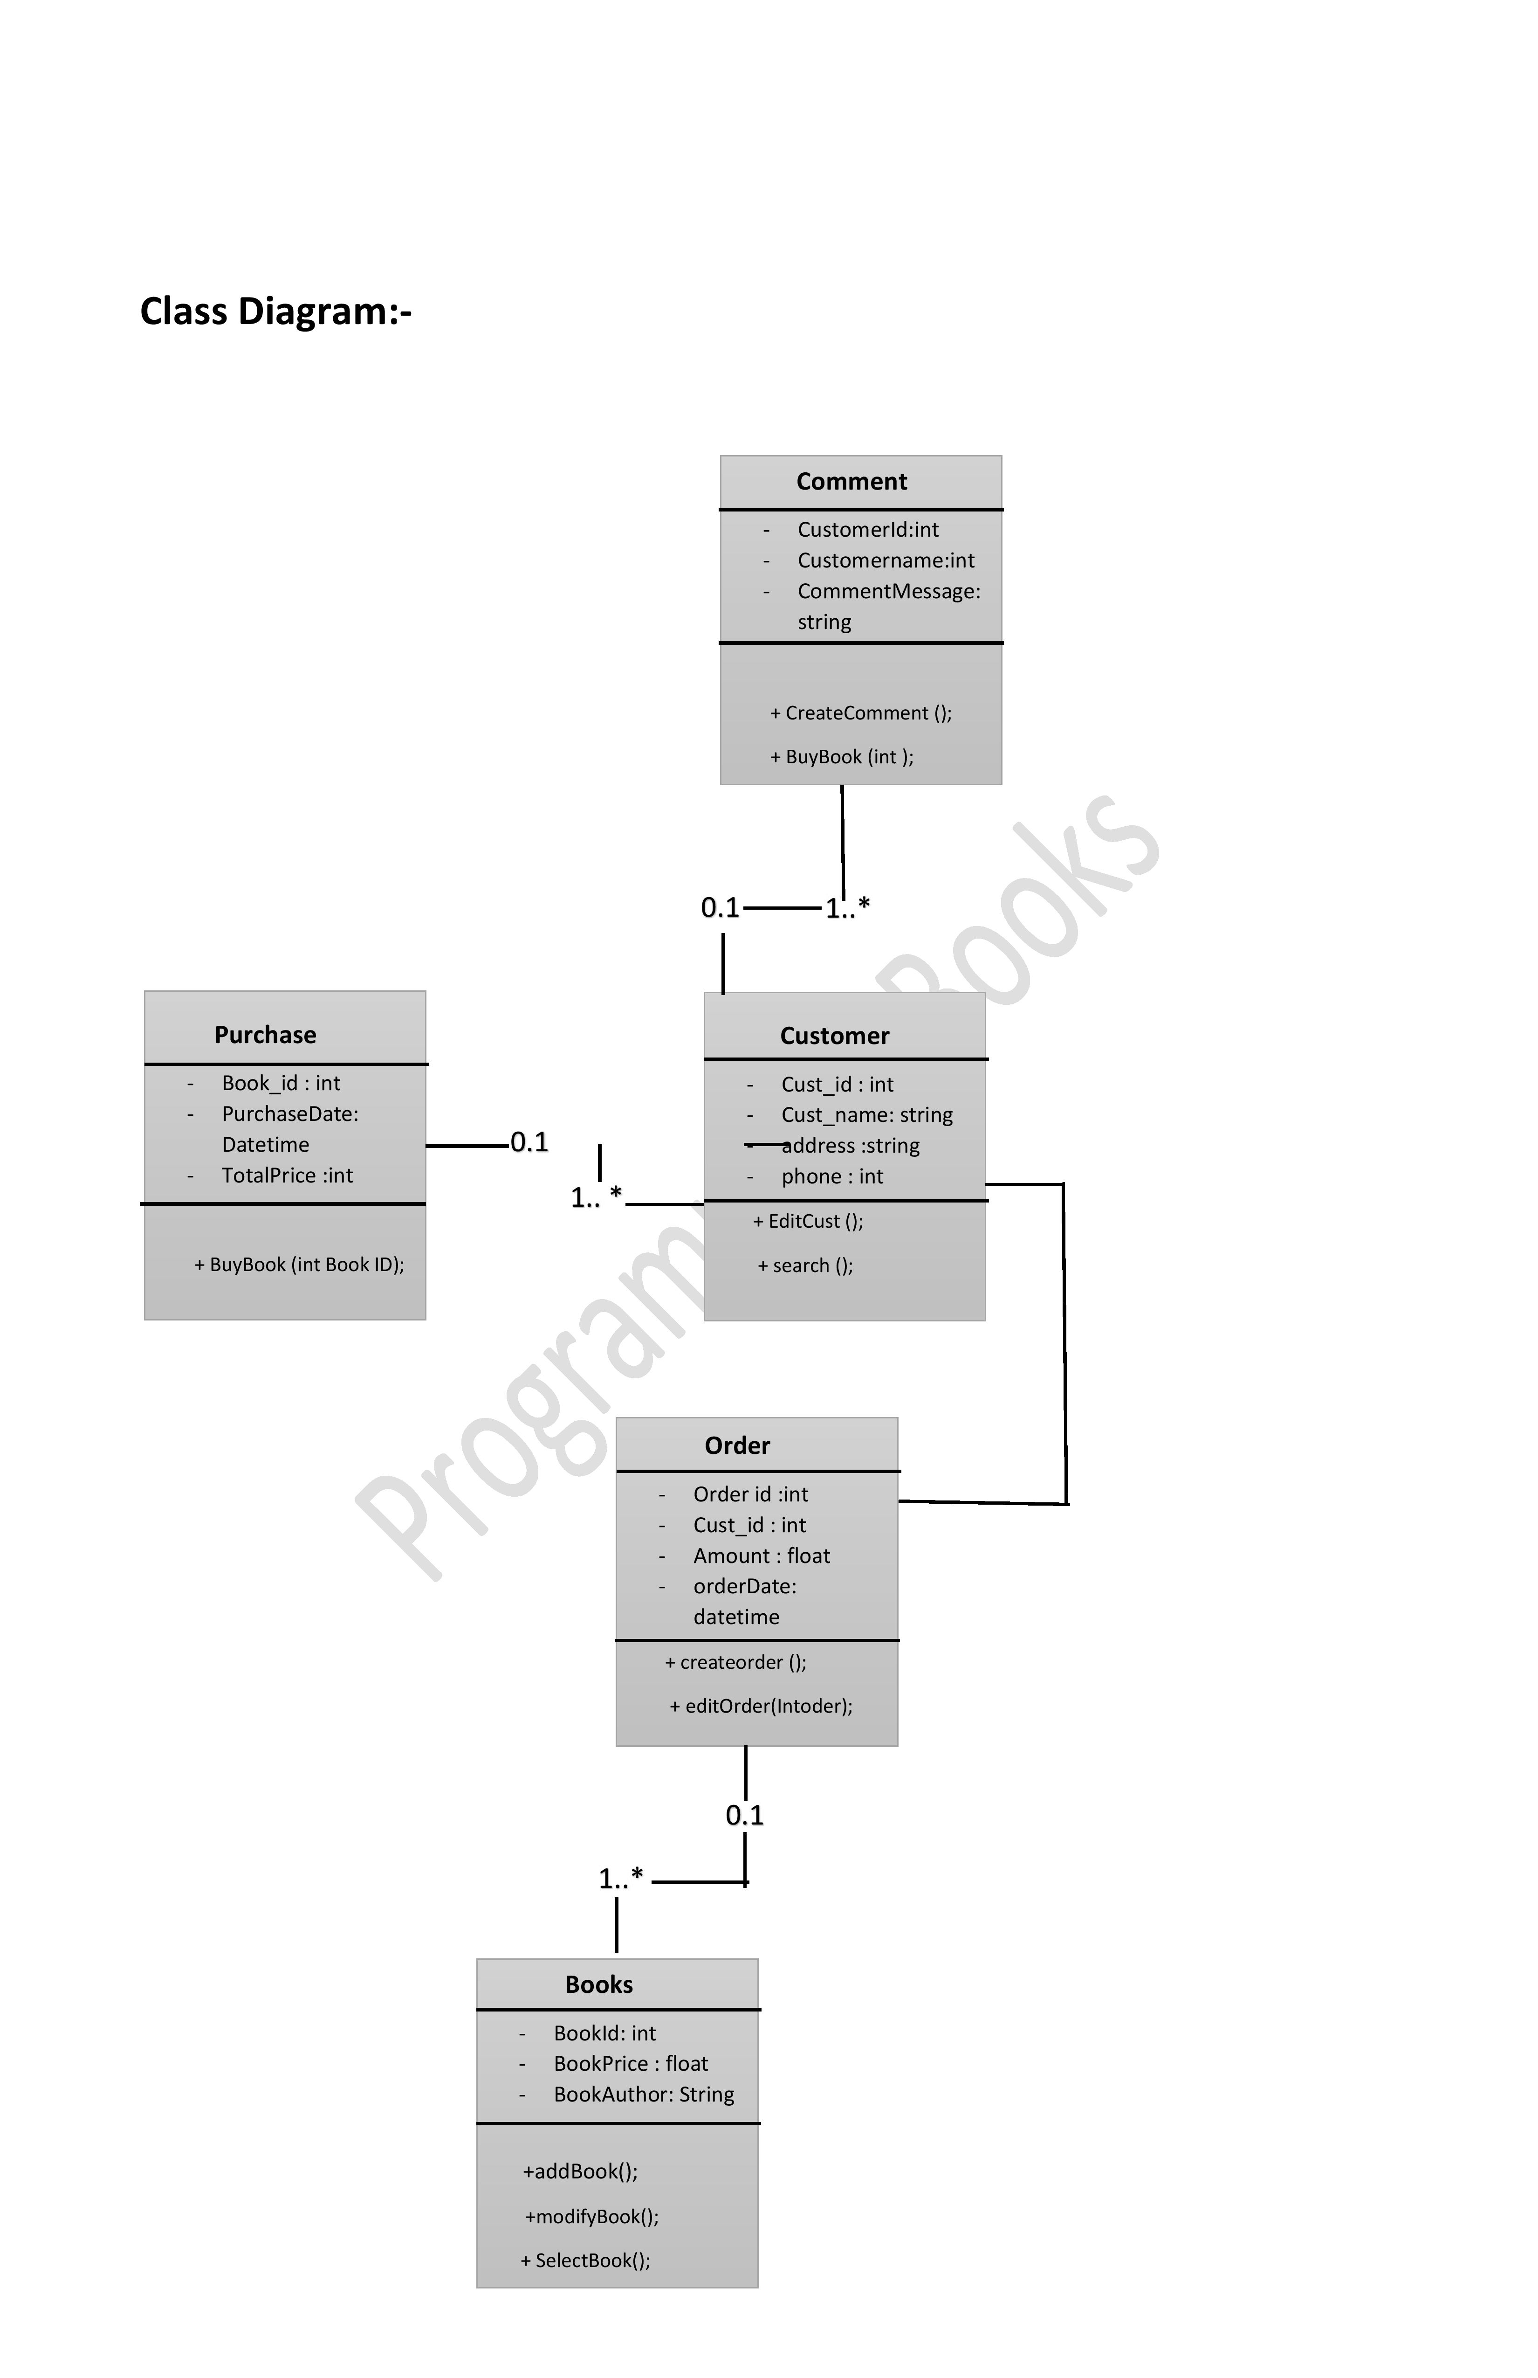

Slide 15
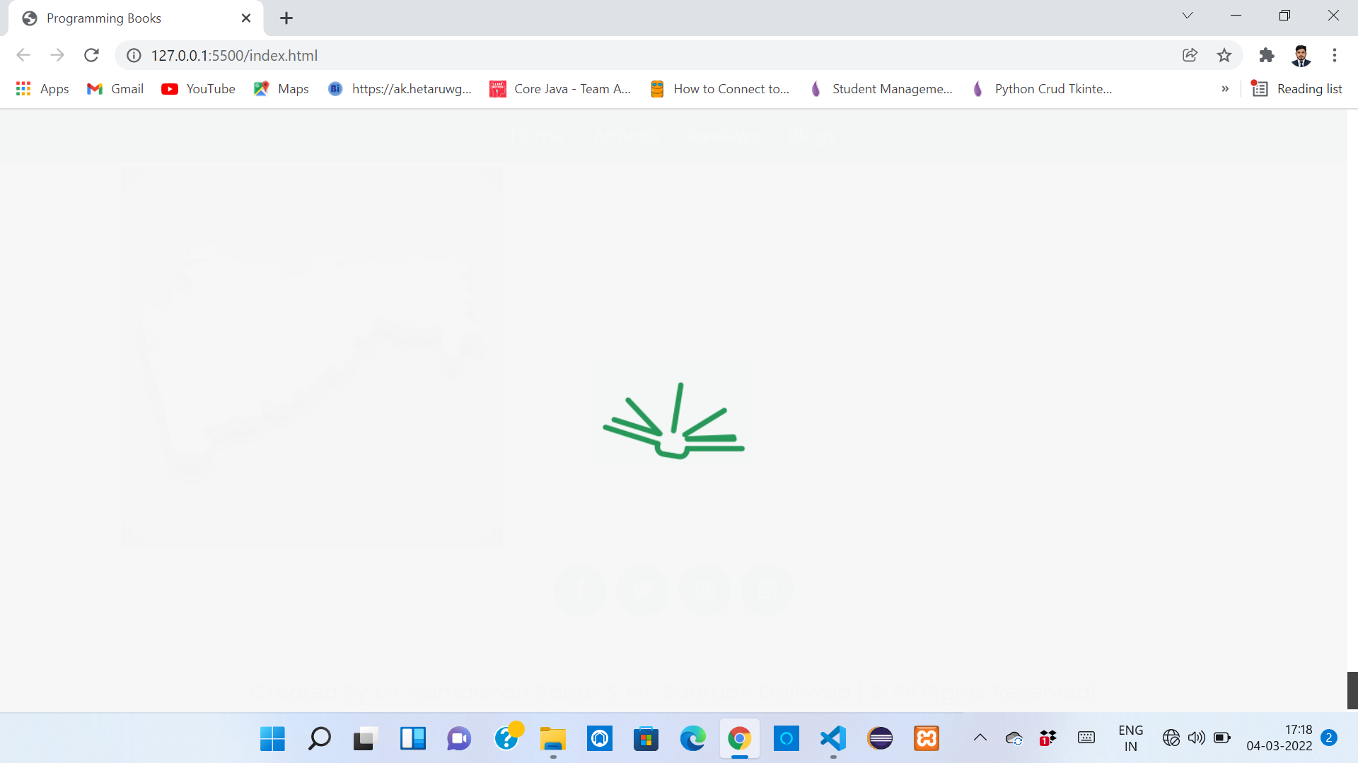
Loading View

Slide 16
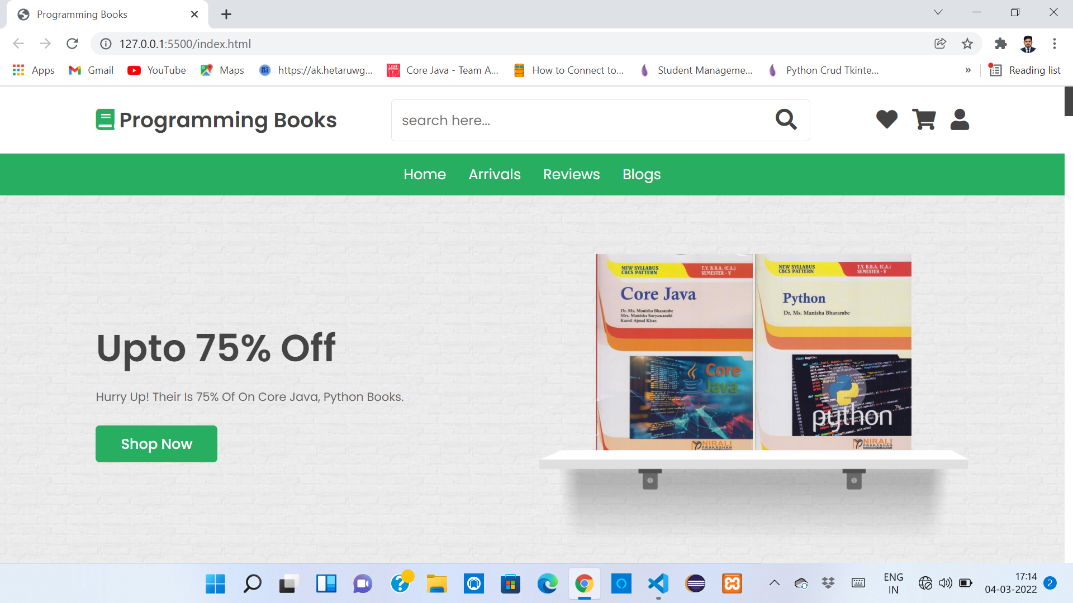
First View

Slide 17
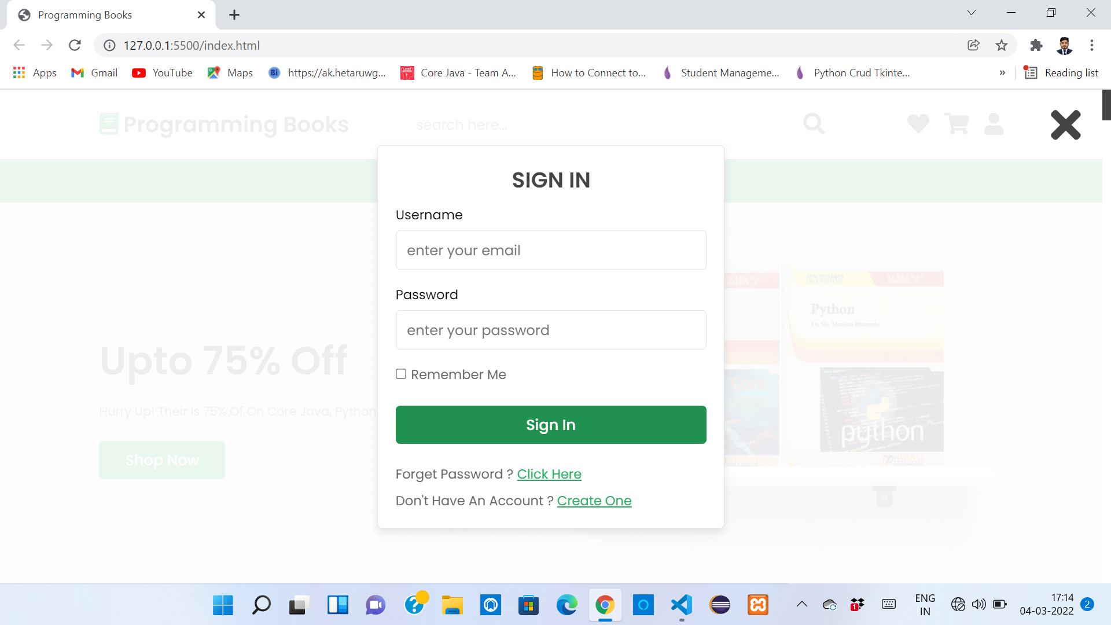
Sign in Section

Slide 18
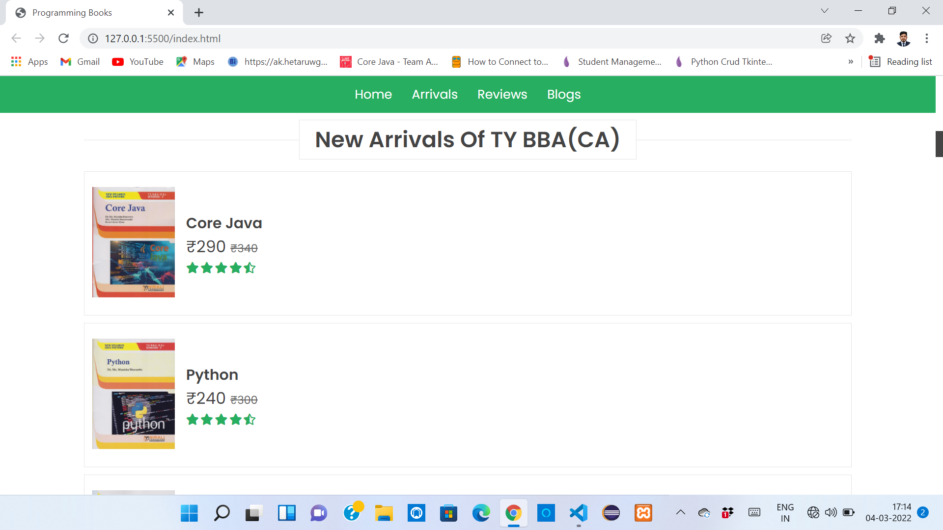
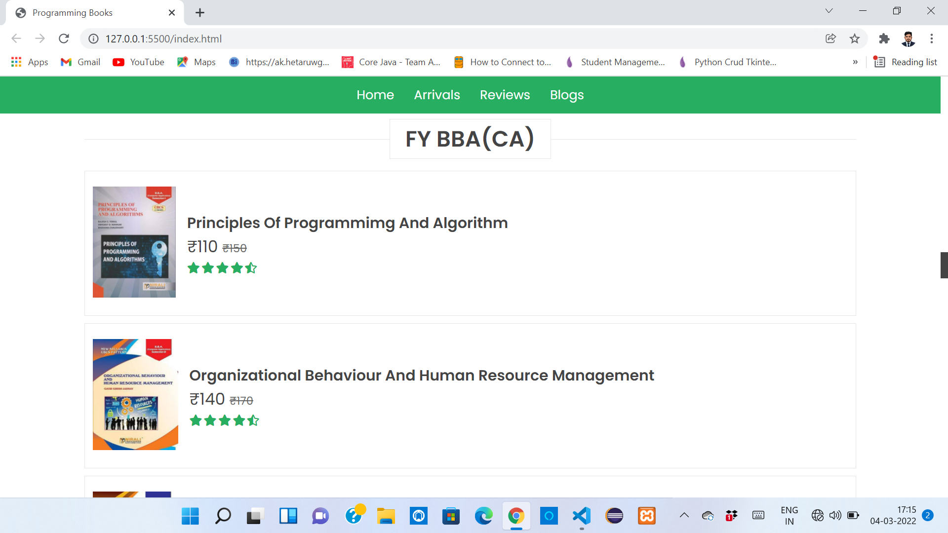
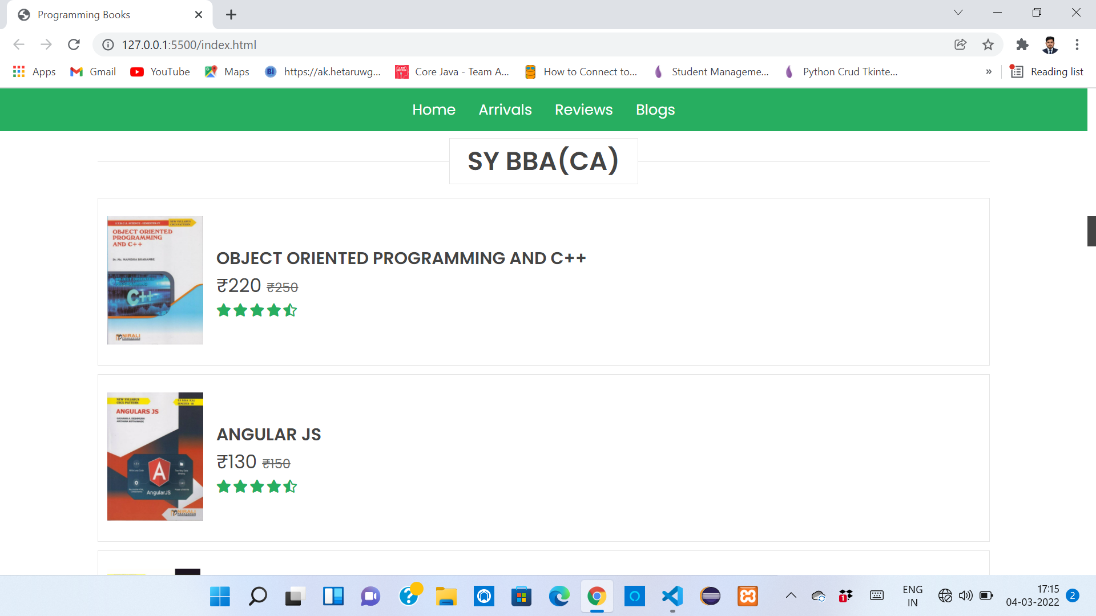
Book Sections

Slide 19
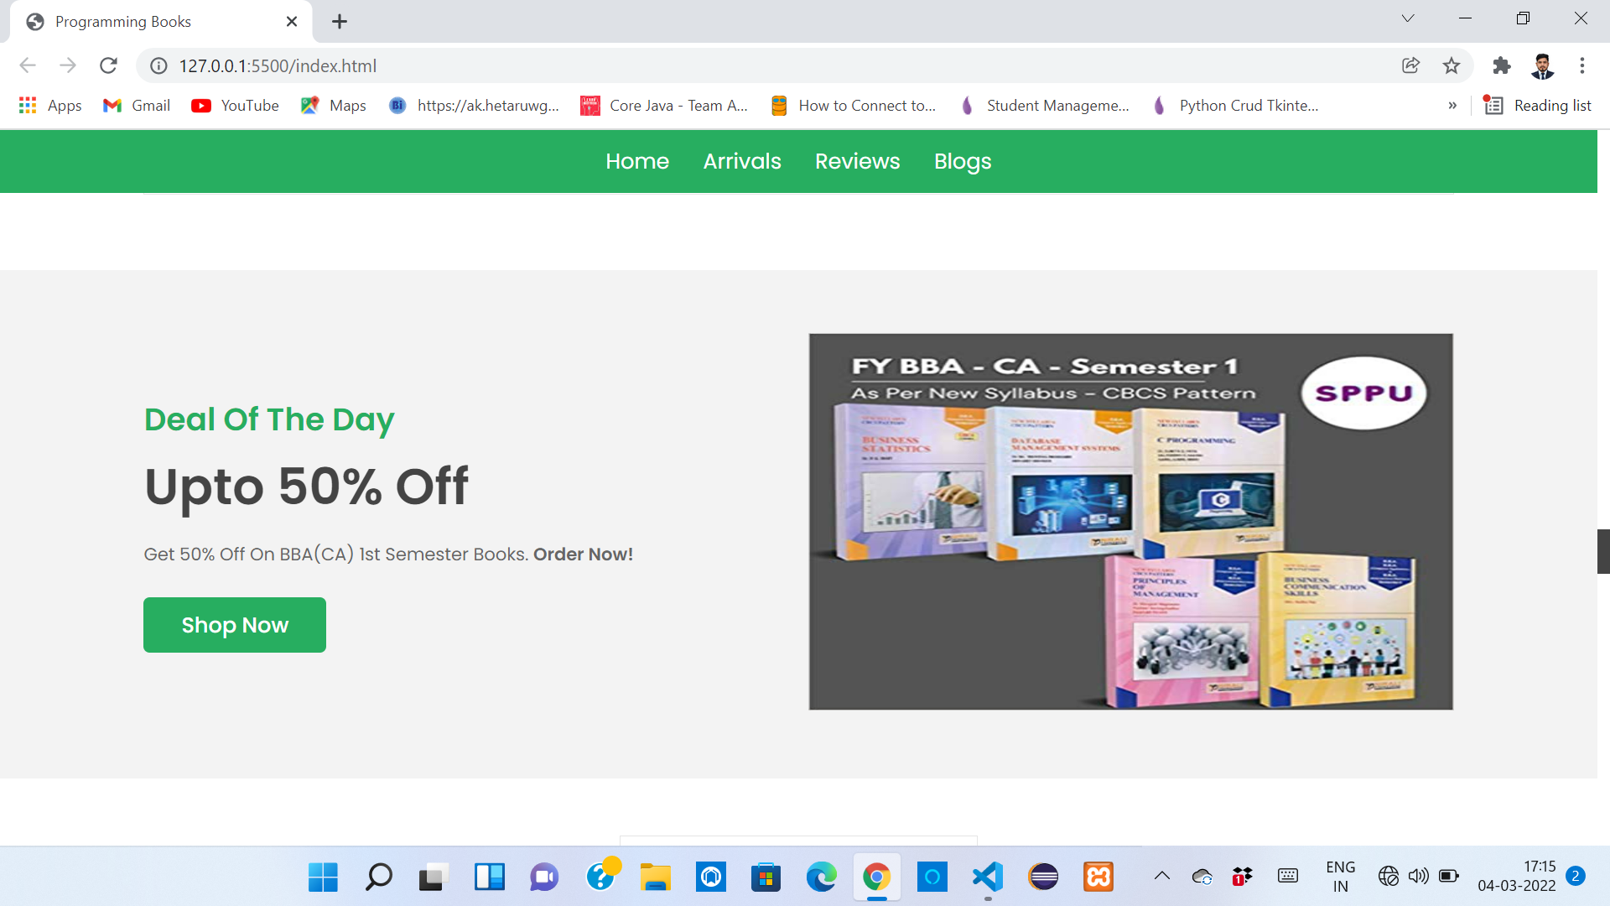
Deal Section

Slide 20
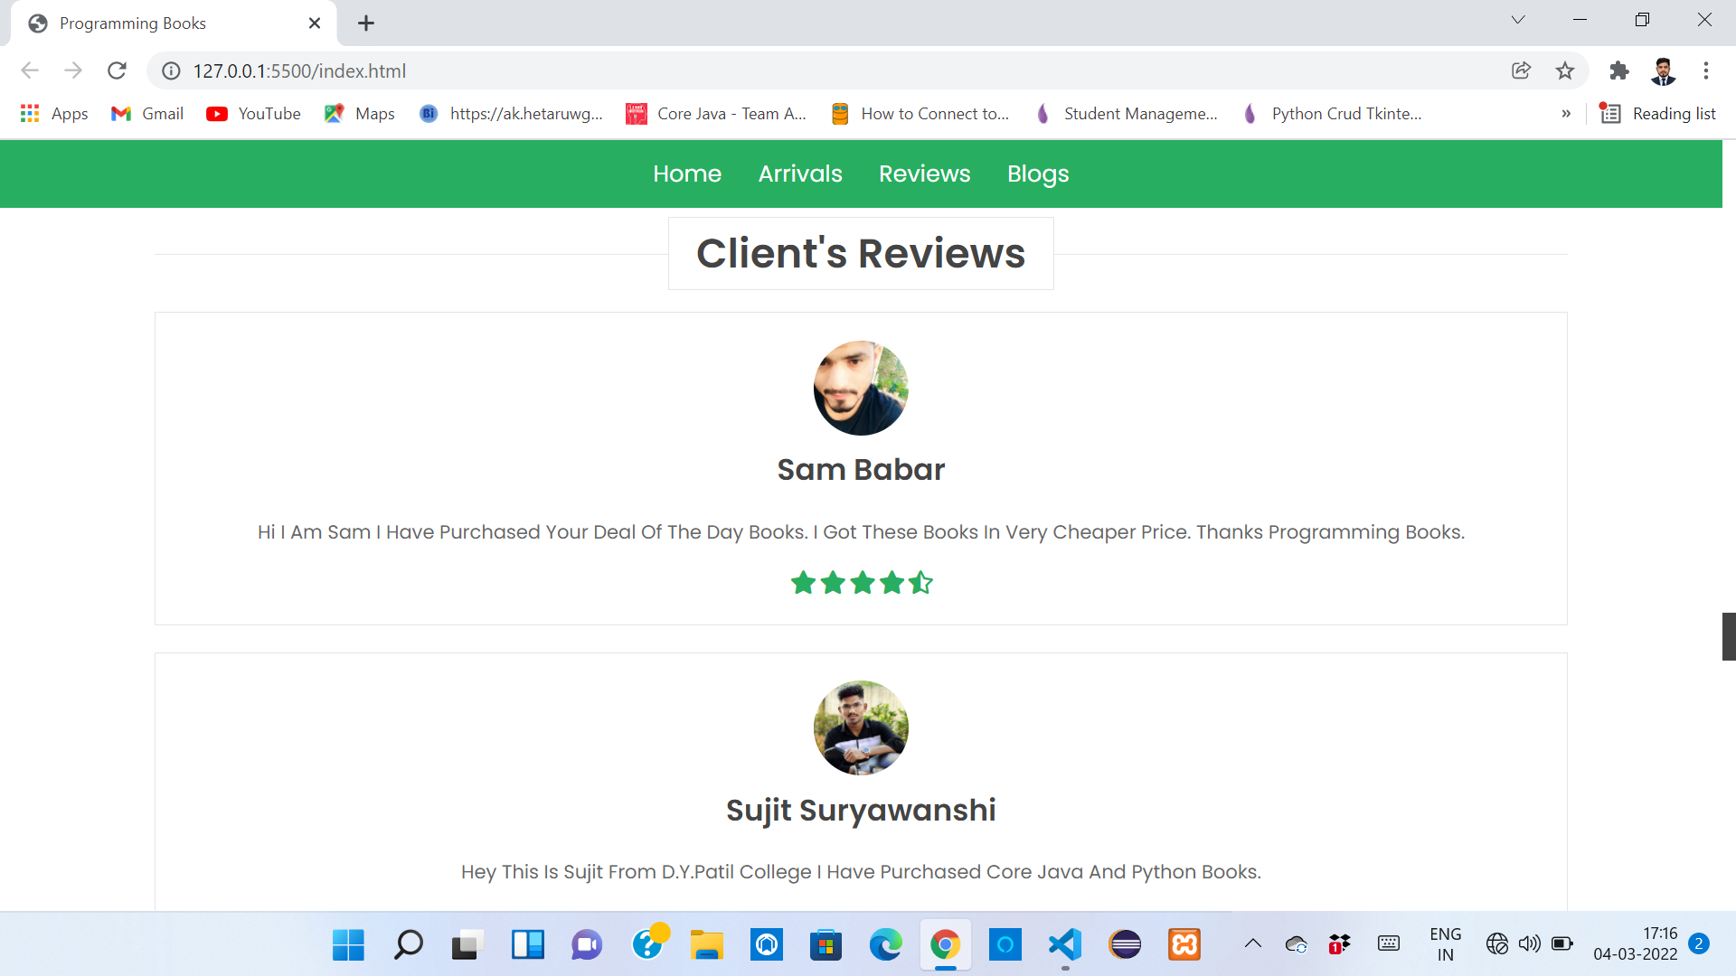
Review Section

Slide 21
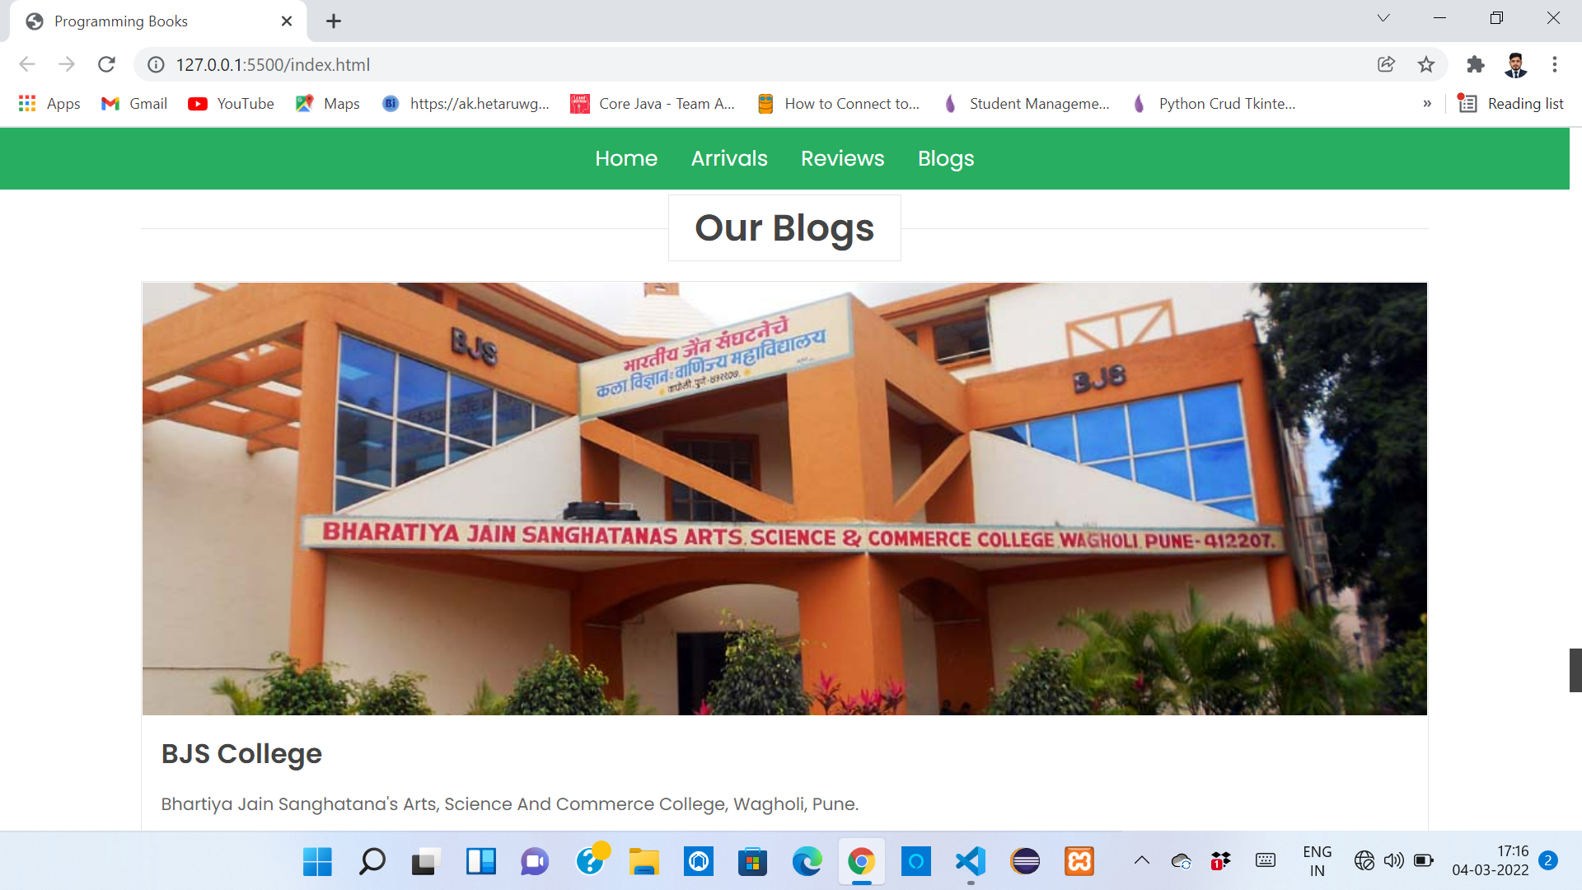
Blogs

Slide 22
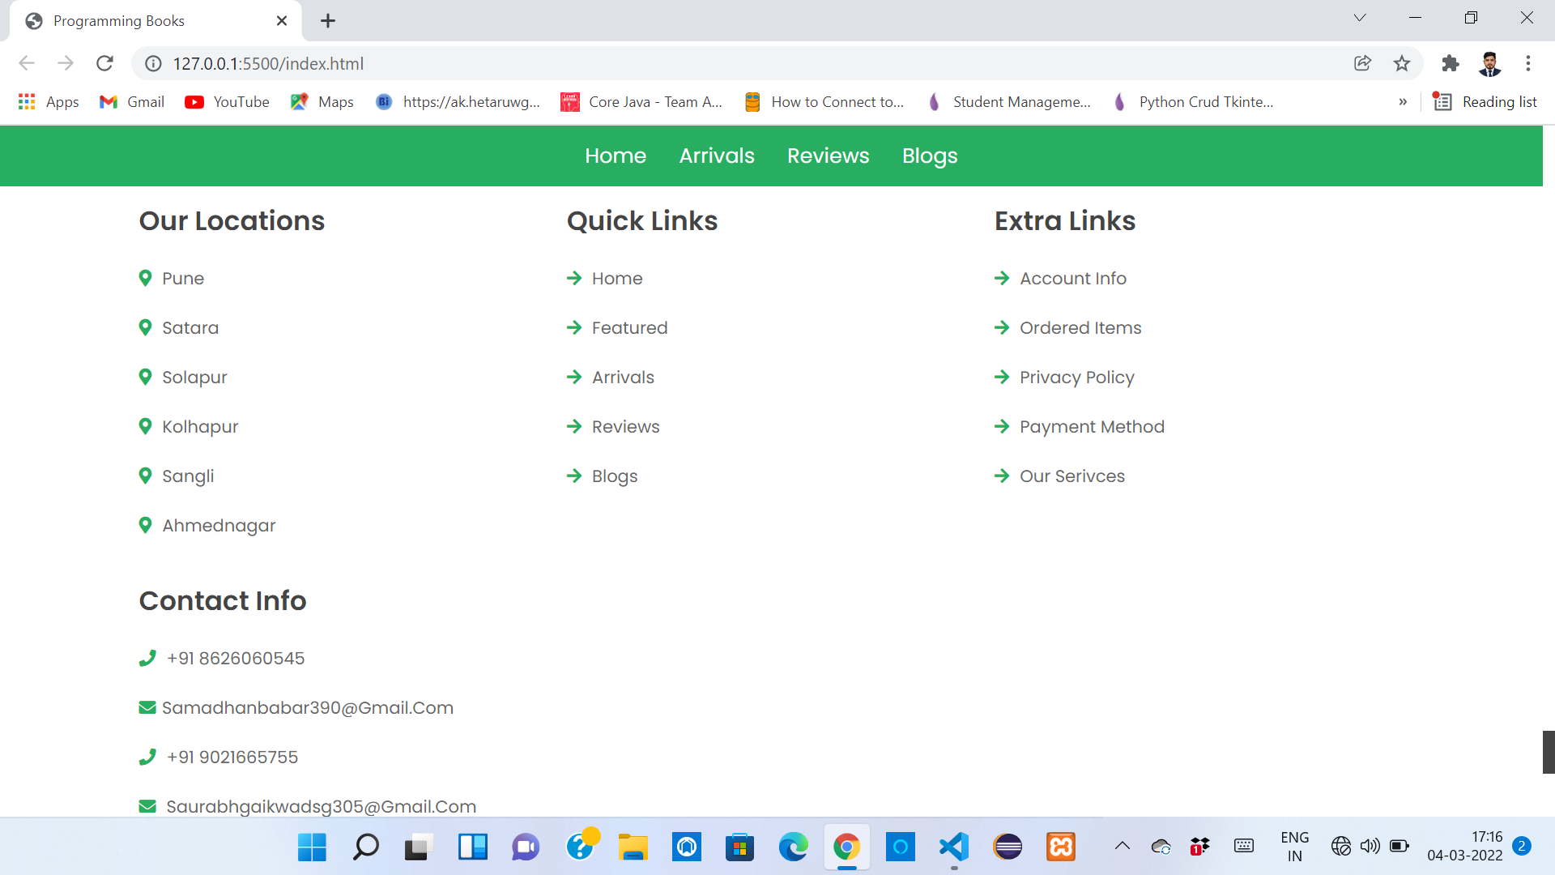
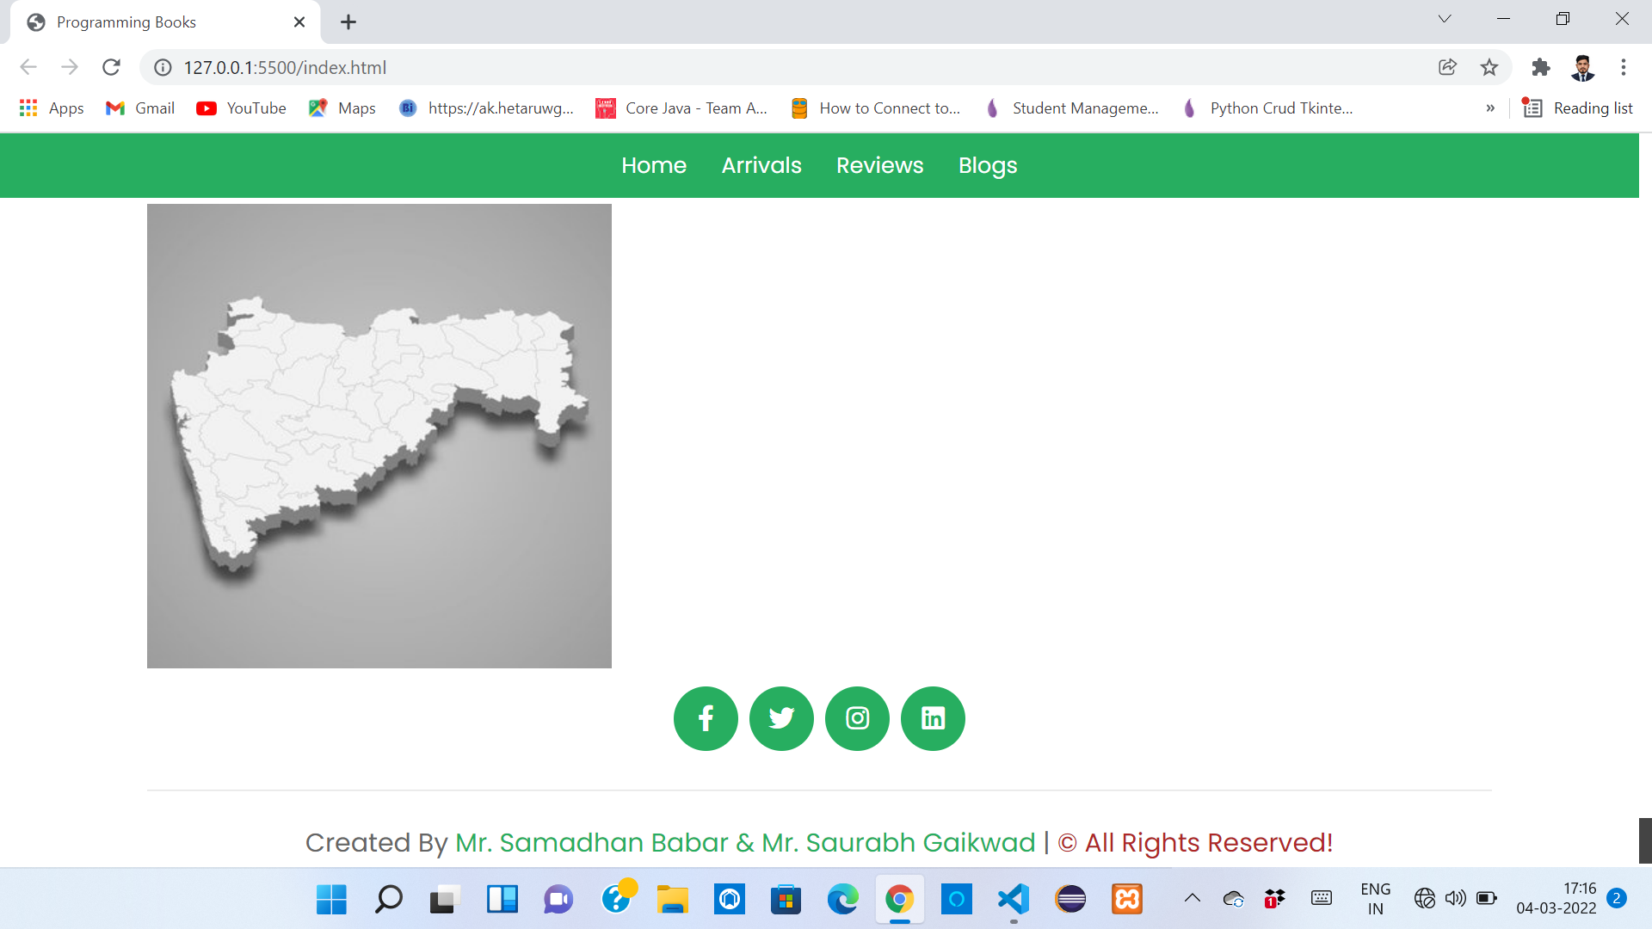
Last View

Slide 23
Future enhancement
As no website is complete in all respects, there are aspects where the website can be always improved upon. Thus the new website leaves chances for further improvement, which can be described as follows.
1. The site can include a tool through which we can generate
Graphical reports because of which we decision making would
Become easier.

Slide 24
Bibliography
Websites:-
www.google.com
www.w3resourse.com
www.youtube.com
Books Referred:-
Web Technology
HTML and CSS (Reference)
Software Engineering

Slide 25
Thank You…

